Slide 1
Grammar
Fourth stage / 1st semester

Slide 2
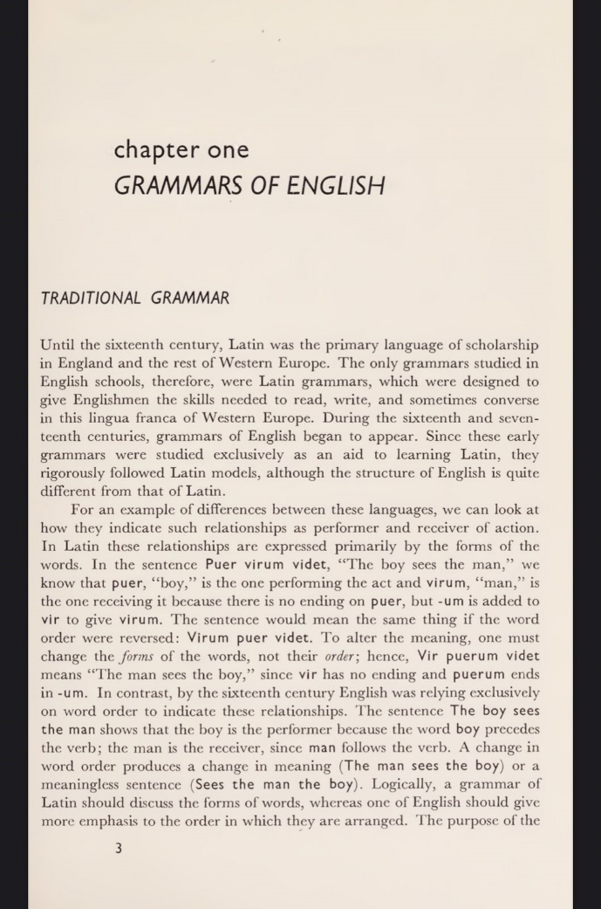
An Introductory to Transformational Grammar
Chapter one
Grammars of English
Traditional grammar : ( 16 and 17th centuries)
Q: When did English grammar start to appear?
During the sixteenth and seventeenth centuries , grammars of English start to appear.
Why did the early English grammar follow the Latin models?
- Because the English grammar were studied exclusively as an aid to learning Latin.

Slide 3
Q: What is the difference between English and Latin ?
Or How can we see the difference between English and Latin?
On the difference between English and Latin, we can look at how they indicate such relationships as performer and receiver of action. In Latin, these relationships are expressed primarily by the forms of the words. In the sentence (puer virum videt, the boy sees the man ) we can have the same result if we only change the order of the words. One need to change the words to have different meanings. In contrast, by the sixteenth century English was relying exclusively on word order to indicate these relationships. The sentence (the boy sees the man) shows that the word boy is the performer because it precedes the verb ; the man is the receiver, since man follows the verb. A change in word order produces a change in meaning.

Slide 4
Q: What was the purpose of the early English grammars ?
It wasn't to provide an accurate description of the language , but rather to serve as a basis for the study of Latin grammar.
According to English traditional grammar, why do we have to say " it is I rather than it is me" ?
- They reasoned that since the subjective complement means the same thing as the noun it renames, people should say it is I.

Slide 5
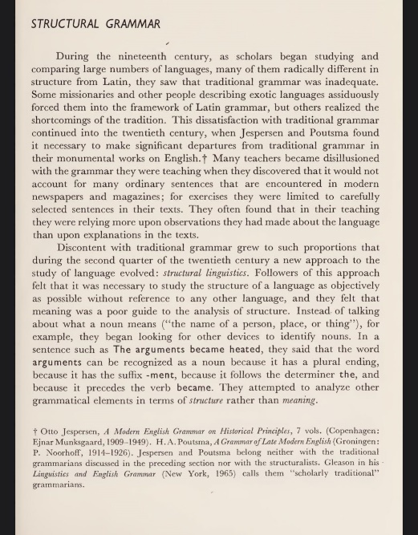
Structural Grammar: (19th and 20th centuries)
Comment on the following : “ during the 19h century,
many scholars saw that traditional grammar was inadequate."
الإجابة في الكتاب ص –
5
Q: Why and when did structural linguistics evolve?
- Discontent with traditional grammar grew to such proportions that during the second quarter of the twentieth century a new approach to the study of language called structural linguistics evolved. Followers of this approach felt that it was necessary to study the structure of language objectively as possible without reference to any other language, and they felt that meaning was a poor guide to the analysis of structure.

Slide 6
Q: How can we identify the word arguments in the arguments became heated" as a noun according to structural linguistics ?
It can be recognized as a noun because it has a plural ending, because it has the suffix - ment, because it followed the determiner the , and because it precedes the verb became.
Comment on the following : " structural linguists attempted to analyze the grammatical elements in terms of structure rather than meaning”. -
الاجابة هي الفقرة الثانية من ص
5
Q: What happened after the publication of Leonard Bloomfield 's language in 1933?
The term linguist became specialized to mean only the person concerned with the new scientific study of language.

Slide 7
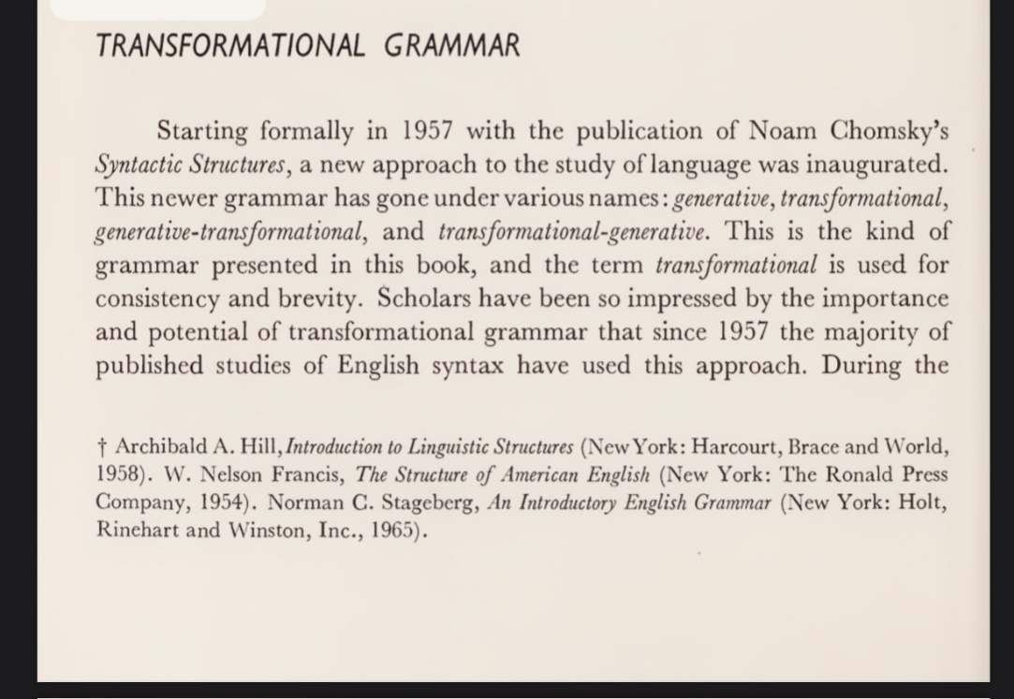
Transformational Grammar:
Q: When and how did TG start?
Starting formally in 1957 with the publication of Noam Chomsky's
syntactic structure. This newer grammar has gone under
various names: generative , transformational, generative
transformational. The term transformational is used for consistency and brevity.
Q: What is an adequate grammar to a transformationlist grammarian ? Or what are the basic characteristics of TG?
An adequate grammar of English should enable a person to produce not just those sentences that have been said in the past, but all the sentences that a native speaker is capable of creating or understanding. In addition, the grammar should not generate sentences that a native speaker would reject, such as * the man horrified the door.

Slide 8
Q: What is the difference between standard and non-standard usage of language ?
ابحثوا عن الاجابة ص7
Q: What is the thing that matters to transformationlists?
Transformationlists are concerned with the system that underlies the language rather than the actual speech of an individual at any given time.
Q: Why do transfromationlists pay attention to the system not the speech?
Transformationalists pay attention to the system because All speakers occasionally stammer, make false starts etc. In addition, speech may be affected by physical surroundings , emotions , memory limitations, distractions, etc. it is the language (the underlying system ) (competence ), not actual speech output (performance), that is the primary interest to the transformationlist.

Slide 9
Q: What is the similarity between TG and traditional grammar?
- TG assigns each sentence an underlying structure that is called a deep structure some traditional grammars used a similar concept in speaking of “ understood” elements For example, they said that Tom is taller than I has the underlying form Tom is taller than I am tall and that imperative sentences such as come here have an understood subject you. Transformational grammarians agree , but apply this idea of underlying structure to every sentence and express it in a more abstract form than traditional grammarians did.

